Slide 1



brix.
Propel Challenge. Future of XYZ Challenge
Catch money moments before they pass.
of Gen Z have paid for a trial they forgot.
An AI money assistant for college students: trials, aid refunds, gift cards and first investments.
59%
Notes:
Hi, I’m David, and this is Brix. Students don’t lose money in one big mistake. They lose it at small moments nobody warns them about. 59 percent of Gen Z have already paid for a trial they forgot. Brix catches those moments.

Slide 2
Agenda
01
Team
Slide 3
05
Product demo
Slides 7–8
02
06
Competition, market, model
User and problem
Slide 4
Slides 9–11
03
Proof: customer discovery
Slide 5
07
Plan and ask
Slides 12–13
08 Value delivered Slide 14
04
Unique insight
Slide 6
Notes:
Here’s the road map: who we are, the user and their problem, proof from customer discovery, our unique insight, the product demo, then competition, market, model, plan, ask, and the value Brix delivers.

Slide 3

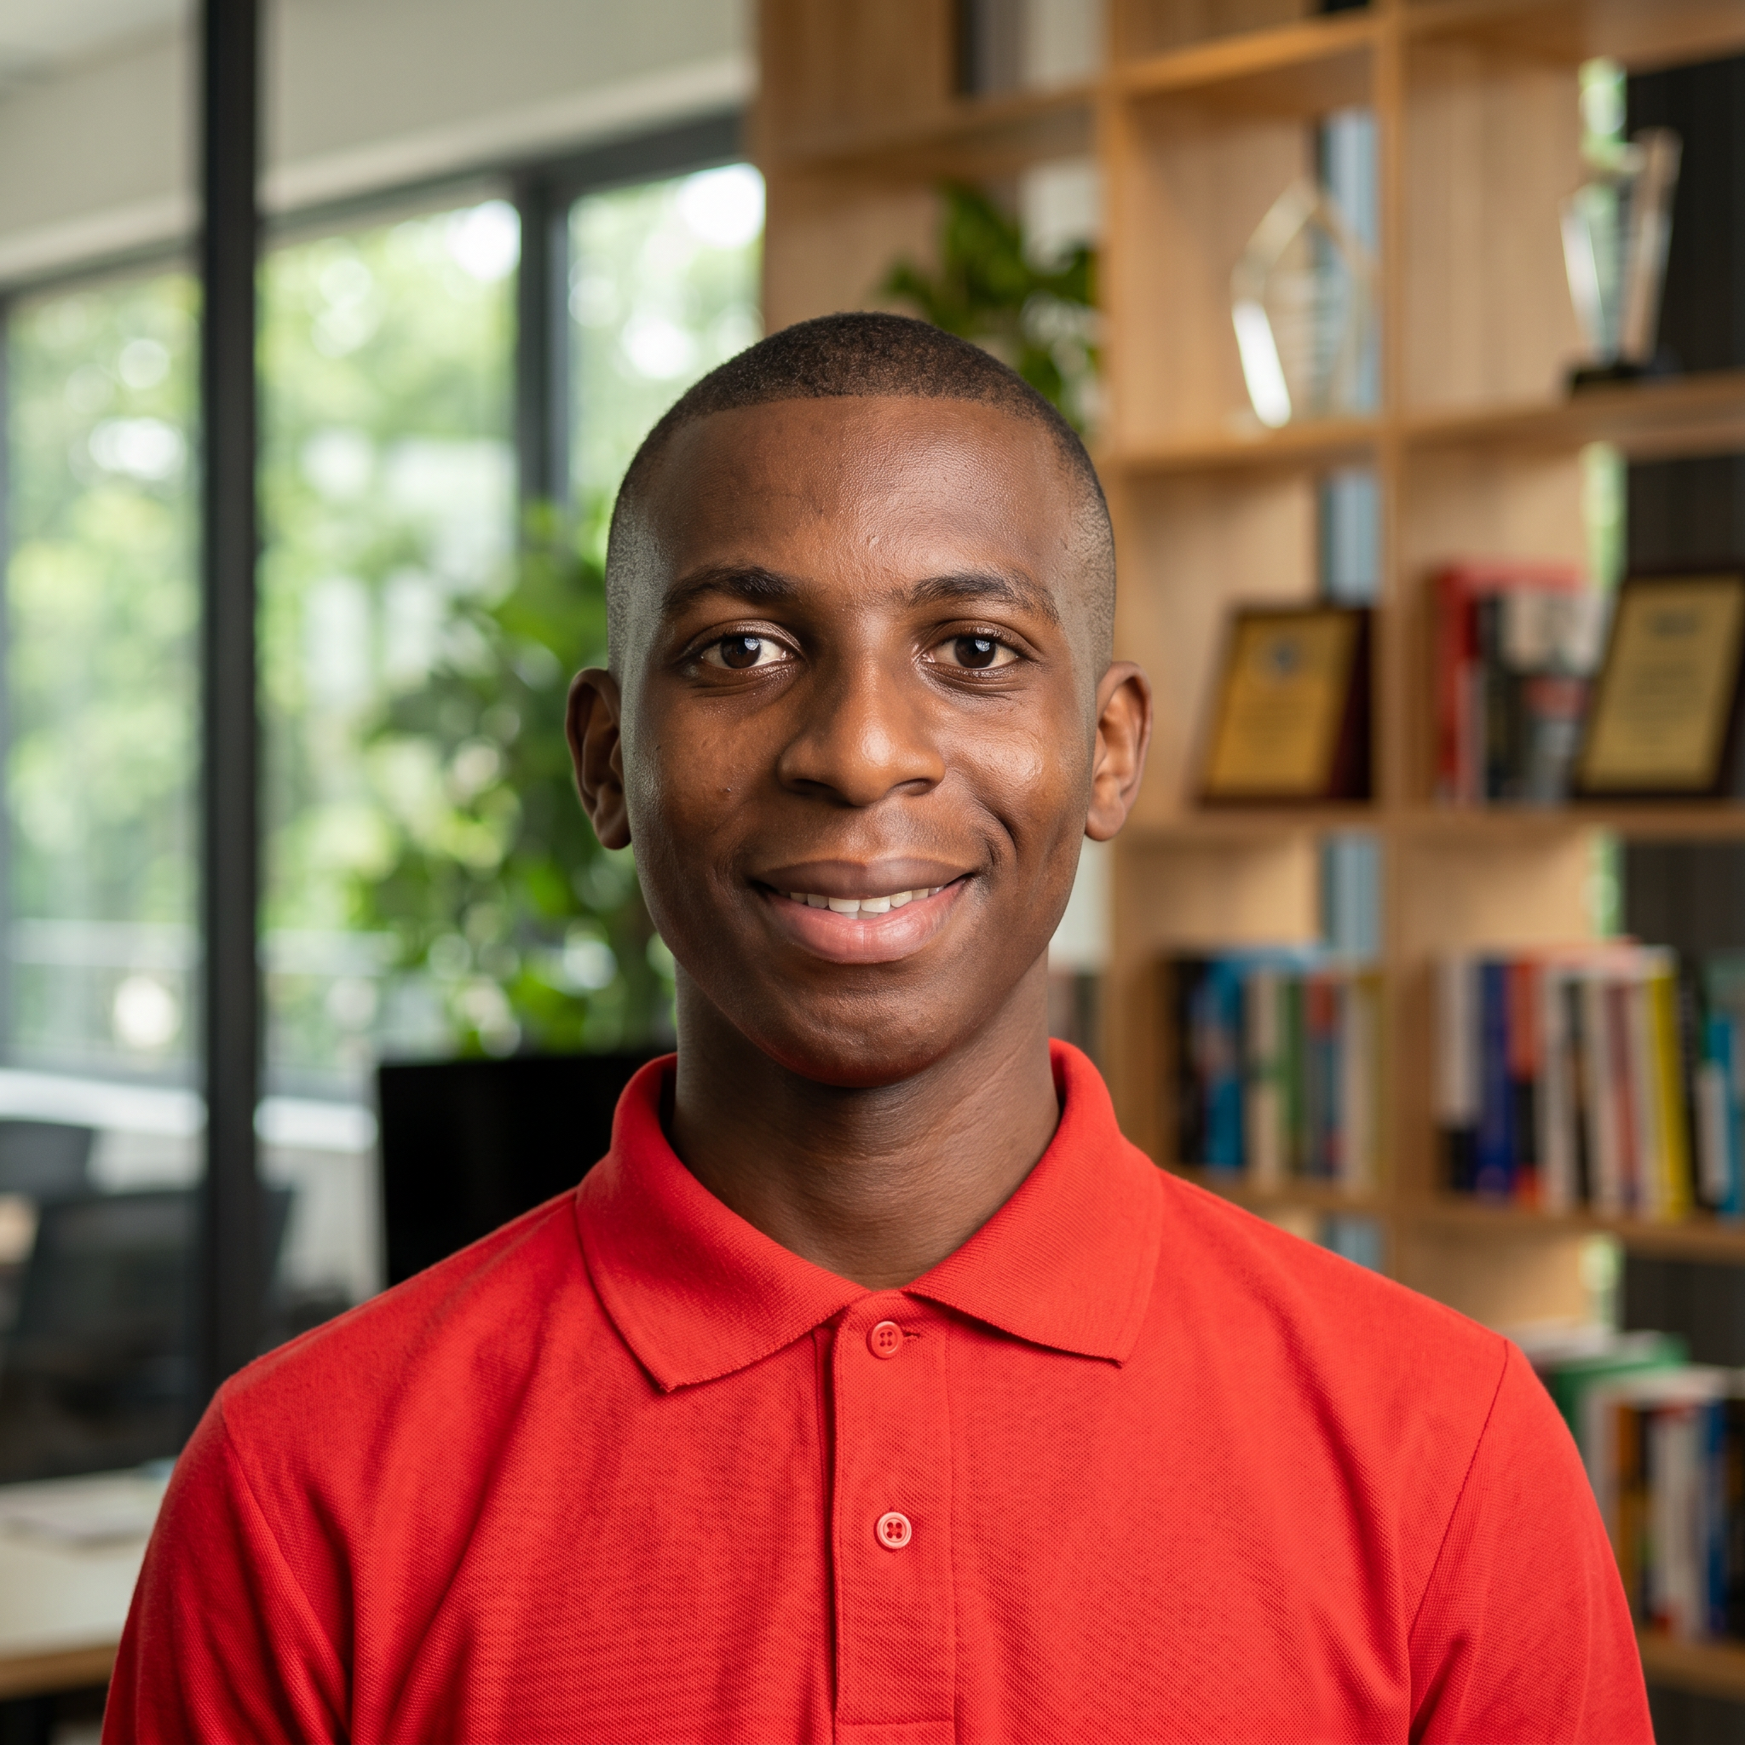
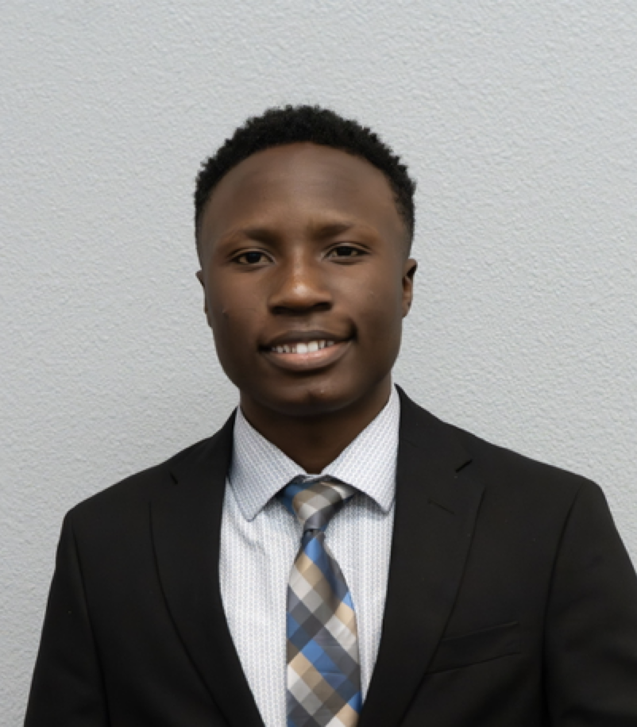
Meet the team behind Brix
DA
David Adedeji
Nicholas Nettey
Angel Yuzya
Team Brix · Propel Challenge
Notes:
I’m David Adedeji, and this is the team behind Brix. [Introduce each teammate and what they built.]

Slide 4
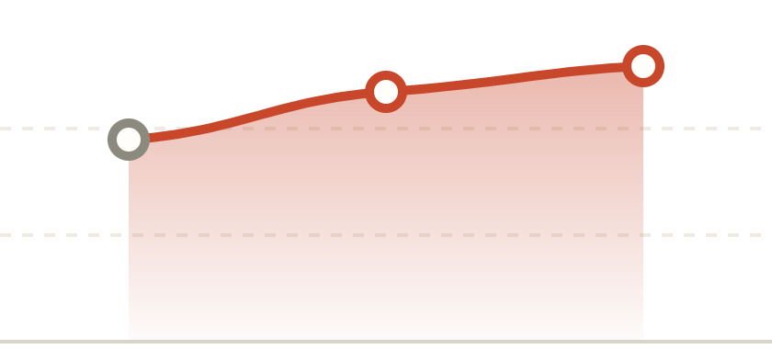
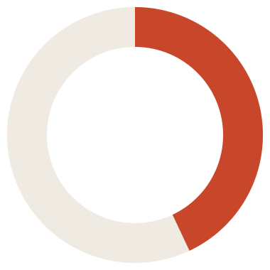

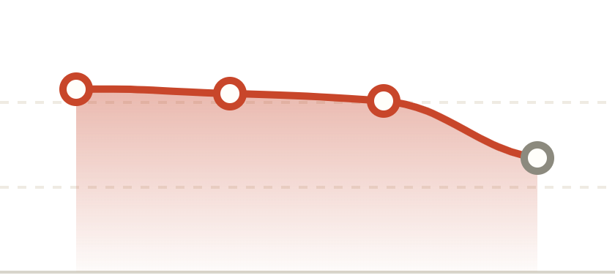
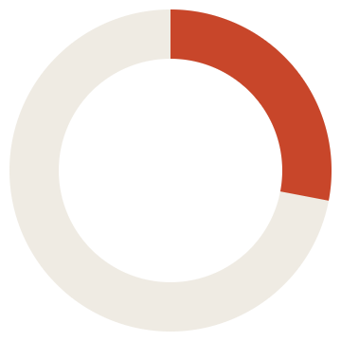
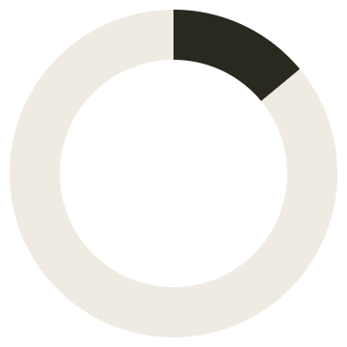
Four money moments students get wrong
1 · FORGOTTEN TRIALS
2 · UNSPENT GIFT CARDS
48%
$27B
43%
of Americans paid for a trial they forgot to cancel.
sits unspent on gift cards across the U.S.
All
48%
Gen Z
59%
Millennials
65%
Average unspent
$187 → $244
2024 U.S. survey (9to5Mac)
hold one
Bankrate, 2023 and 2024
3 · HIDDEN LOANS
4 · WHO TO TRUST
28%
48%
of first-year borrowers said they had no federal loans.
28%
14%
of Gen Z investors learned investing from social media.
Social
48%
Search
47%
Family
45%
Pro
30%
Akers & Chingos, Brookings
“no federal loans”
“no student debt”
FINRA Foundation & CFA, 2023
Notes:
Four moments. One: almost half of Americans, and 59% of Gen Z, have paid for a trial they forgot. Two: 27 billion dollars sits on unused gift cards. Three: aid refunds often carry loan money, and 28% of first-year students with federal loans said they had none. Four: Gen Z learns investing from social media far more than from professionals. The information exists, but nobody turns it into a decision at the right moment.

Slide 5


Where student need meets a market gap
WHAT STUDENTS NEED
WHAT THE MARKET MISSES
User needs
Market gap
One clear next step at the moment money moves.
Budgeting apps skip refunds, gift cards and practice investing.
Pain points
brix.
Forgotten trials, hidden loans, idle gift cards.
Timing
Money moments
48% of Gen Z investors learn from social media.
Unmet demand
59% of Gen Z paid for a trial they forgot.
Scalability
Web, WhatsApp, phone, bank white-label and an API.
Notes:
Our insight sits where two things overlap. Students need a nudge at the moment money moves, and the market, built for general adults, doesn’t give it to them. Brix lives in that overlap.

Slide 6

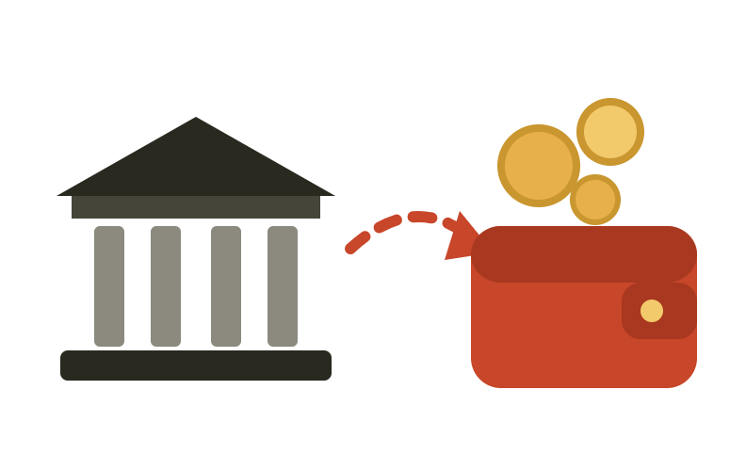

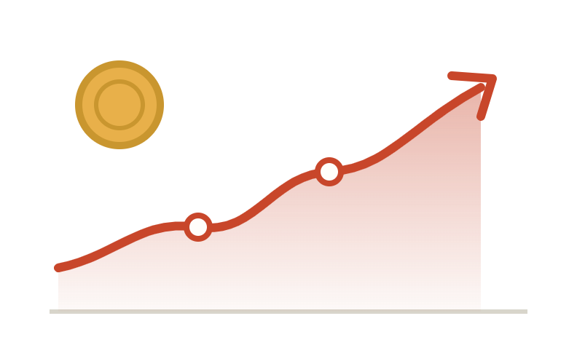
Brix shows up at each moment, with one next step
brix.
BEFORE A CHARGE
WHEN A REFUND LANDS
BEFORE IT EXPIRES
BEFORE REAL RISK
Trials, caught
Gift cards, spent
Investing, practiced
Loans, spotted
Predicts the next charge and reminds you 7 and 2 days before it bills.
Shows the borrowed part and the 120-day window to return it with no interest.
Tracks balances and alerts you 14 and 3 days before a card expires.
Virtual money at live prices, auto-invest, and the S&P 500 to beat.
Notes:
Brix shows up at each of those moments with one clear next step: before a charge, when a refund lands, before a gift card expires, and before you risk real money. It’s read-only, nothing happens without your yes, and every answer shows where it came from. Let me show you. [Switch to the app.]

Slide 7
Product demo
See it in action:
1
2
3
Connect
Catch the moment
Act on one step
Link your accounts read-only, then talk to Brix on the web, WhatsApp or a phone call. It never moves money.
Brix finds the next trial charge, the borrowed part of an aid refund, or a gift card about to expire.
You get one clear next step with its sources. Nothing happens until you say yes.
Notes:
Three steps. One: connect read-only, and talk to Brix wherever you are. Two: Brix catches the moment. Three: you get one next step and nothing happens without your yes. [Switch to the live app for the demo.]

Slide 8

Why Brix, not another budgeting app
What students need
Brix
Rocket Money
YNAB
Trial and subscription alerts
Yes, 7 and 2 days before
Tracks subscriptions
Manual budgeting
Borrowed money in aid refunds
Yes, with return date
No
No
Gift card balances and expiry
Yes, with alerts
Not a focus
Not a focus
Practice investing, live prices
Yes, virtual money
No
No
Voice call and WhatsApp
Yes
No
No
Public developer API
Yes
No
Yes
Price
Free core; Plus $3.99/mo
$7–14/mo; 35–60% fee on negotiated bills
$109/yr; free year for students
The only assistant built around student decision moments, and the only one that turns an aid refund into a plan.
Green: Brix has it. Red: the competitor doesn’t. From public pricing pages and reviews, October 2026; they may change.
Notes:
Rocket Money and YNAB are good tools, but they’re built for general adults and charge for the useful parts. Everything in green is Brix; everything in red is a gap. Brix catches the refund and loan moment nobody else touches, tracks gift cards, lets you practice investing safely, and reaches you by phone and WhatsApp. The core is free.

Slide 9






A big, reachable first market
19.4M
college students
19.4M U.S. college students
Everyone who signs up for trials, gets aid refunds and starts investing.
About $931M a year
$931M
19.4M students × $48 a year for Brix Plus. Bank partners add a second channel.
a year
50,000 students by year two
25 campuses, starting with one pilot campus, plus 2 bank or credit-union pilots.
50K
year two
Enrollment: National Student Clearinghouse Research Center, fall 2025. Pricing, market value and user goals are our planning assumptions.
Notes:
There are 19.4 million college students in the U.S. At 48 dollars a year, that’s about a 930 million dollar consumer opportunity, before bank partnerships. Our goal is 50,000 students on 25 campuses by year two, starting with one pilot campus.

Slide 10




Four ways Brix makes money
B2C · STUDENTS
B2B2C · BANKS AND CREDIT UNIONS
Free core, Brix Plus at $3.99/mo
White-label, $1 per member a month
Tracking, alerts and refund plans are free. Plus adds WhatsApp and voice, gift card nudges and practice investing.
Banks like FNB offer Brix in their own app: engaged young customers and a trust story.
B2B · DEVELOPERS
LATER · CARDS
Public API, usage-based
Interchange on real cards
Free tier, then paid usage for campus apps, budgeting tools and fintechs.
With a sponsor bank, single-use cards earn a share of card fees, after a compliance review.
Prices are planned and will be validated with students and bank partners.
Notes:
We make money four ways. Students get a free core and can upgrade to Brix Plus. Banks and credit unions license Brix as a white-label feature, which is the biggest lever and exactly where a bank like FNB fits. Developers pay for API usage. And later, with a sponsor bank, real single-use cards earn interchange.

Slide 11
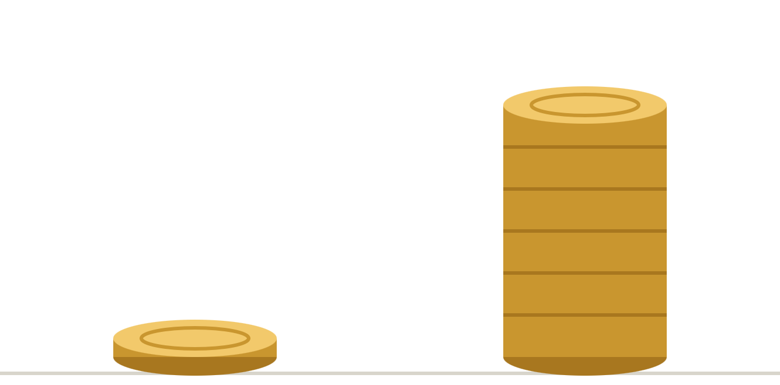
The next two years
NOW – SPRING 2027
First-campus pilot · 1,000 students
Projected revenue
Production bank access, user interviews, security review.
LATE 2027
10 campuses · 10,000 students
Brix Plus launches; first credit-union pilot.
2028
25 campuses · 50,000 students
Two bank partners, paying API customers, real cards with a sponsor bank.
Year 1
$60K
Year 2
$720K
Year 2: 4,000 Plus × $48 + 2 banks × 20,000 members × $12 + API.
Projections from our planning assumptions (8% paid conversion by year two), not results.
Notes:
Here’s the plan. A pilot on one campus first, then 10 campuses and a credit-union pilot, then 25 campuses, two bank partners and real cards by 2028. That’s about 60 thousand dollars in year one and 720 thousand in year two, with banks as the biggest share.

Slide 12

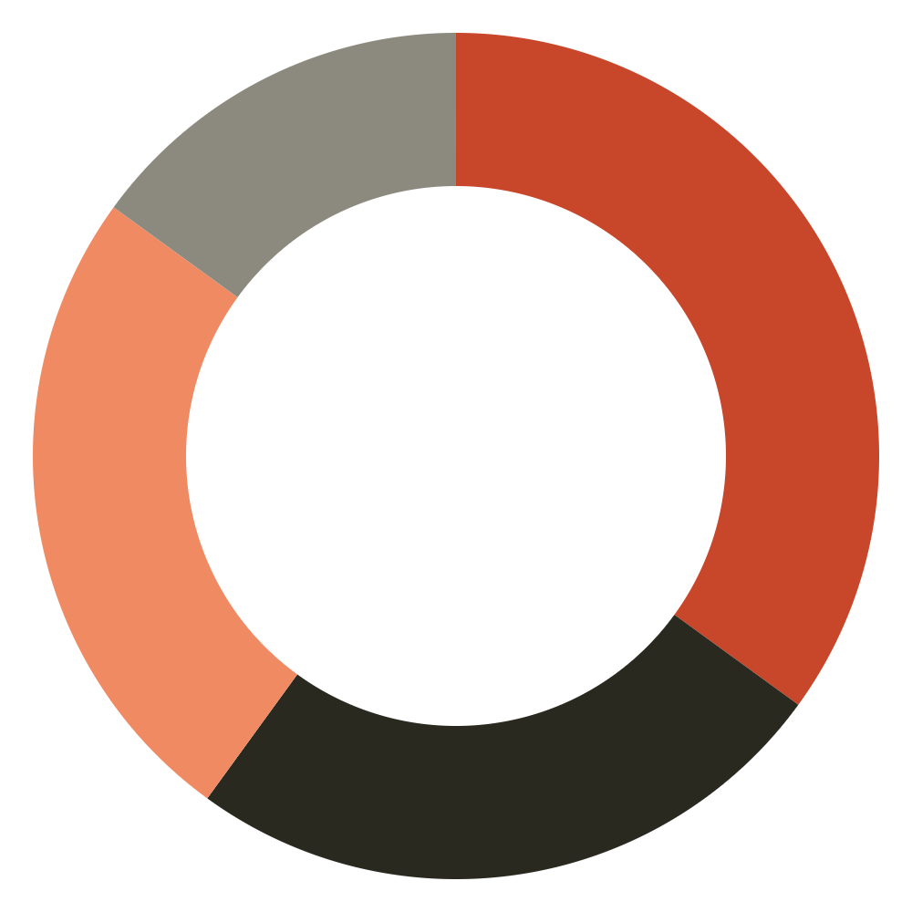
Whatever we win, every dollar has a job
35% · Product and security
Production bank data and a security review.
25% · Compliance and bank partners
Every $1
Legal review and a pilot with a bank like FNB.
we win, split like this
25% · Campus growth
A first-campus launch with student ambassadors.
15% · Infrastructure and AI
Hosting, model usage, voice and messaging.
For example, $1,000 becomes $350 for product, $250 for compliance, $250 for growth and $150 for infrastructure.
Notes:
Whatever we win goes straight into Brix, and every dollar has a job: 35 percent for product and security, a quarter for compliance and a bank pilot like FNB, a quarter for launching on our first campus, and the rest for infrastructure.

Slide 13



What 50,000 students could keep each year
FORGOTTEN TRIALS
BORROWED REFUND MONEY
GIFT CARDS
$1.2M
$1.4M
$2.0M
if each student skips one $12 charge they didn’t choose, each semester.
in interest avoided if 1 in 10 return $1,000 of unused loans.
of balances spent instead of expiring, at $40 a student.
And a generation that practices investing before trusting a stranger online with real money.
Estimates from our assumptions, not measured outcomes. Loan interest: $1,000 × (1.065⁴ − 1) ≈ $286 a student over 4 years.
Notes:
At 50,000 students, the impact adds up. One avoided trial a semester is 1.2 million dollars kept. If one in ten returns a thousand dollars of unused loans, that’s about 1.4 million dollars of interest they never pay. And 2 million dollars of gift cards actually gets spent.

Slide 14



brix.
Your money, brick by brick.
Try it at www.usebrix.app
or call +1 (870) 395-8999
Scan to try Brix
Let’s build something together. We welcome conversations about partnership, pilots and investment.
David Adedeji · Team Brix · HackPSU Fall 2026 · FNB Challenge
Notes:
Brix catches money moments before they pass, and it’s live right now. Scan the code to try it, or call it. I’m David Adedeji from Team Brix. Thank you.

